Slide 1
Machine Learning CS462
Team Members:
Islam Abd-Elhady Hassanein Mohamed
Enas Ragab Abdel-Latif Mohamed
Mariam Tarek Saad Mohamed

Slide 2

Heart Attack Analysis And Prediction Using Artificial Neural Network

Slide 3
Table of Contents
Executive Summary
Project Overview
Methodology
Neural Network Description
Cross-Validation Technique
Dataset Features
Model Development
Architecture Overview
Training Process
Source Code Snippet

Slide 4
Table of Contents
Results
Performance Metrics
Visuals of Results
Discussion
Analysis of Results
Challenges & Learnings
Conclusions and Future Work
References
Appendix
Contact Information

Slide 5
EXECUTIVE SUMMARY
This project addresses a critical global health concern: heart attacks.
Heart attacks represent a significant health and economic burden worldwide.
Early detection and prevention can save lives and reduce healthcare costs.
Utilizing data analysis and machine learning, specifically Artificial Neural Networks (ANN), to identify and predict heart attack occurrences.

Slide 6
2. Project Overview:
Heart attacks present a critical global health issue, warranting attention due to their life-threatening nature and significant healthcare burdens. This project aims to tackle this challenge by utilizing data analysis and machine learning techniques to develop a predictive model.
The primary goal is to accurately assess individuals' likelihood of experiencing a heart attack, enabling proactive interventions and personalized preventive strategies. Through data preprocessing, exploratory analysis, and machine learning algorithms, the project seeks to uncover key factors contributing to heart attacks and improve patient outcomes.
Ultimately, this project strives to save lives, reduce healthcare costs, and foster a healthier society.

Slide 7
3. Methodology:
Neural Network Description
Basic Concept:
Artificial Neural Networks (ANNs) consist of interconnected nodes (neurons) and edges (synapses) that carry weighted connections between them. Neurons process inputs and produce outputs based on an activation function. Architecture:
The neural network is structured as a sequential model comprising several layers:
Input Layer: A dense layer with 32 neurons, using the ReLU (Rectified Linear Unit) activation function. The input shape is determined by the number of features in the training data.
Hidden Layer: Another dense layer with 16 neurons, also using the ReLU activation function.
Output Layer: A dense layer with a single neuron, using the sigmoid activation function, suitable for binary classification tasks.

Slide 8
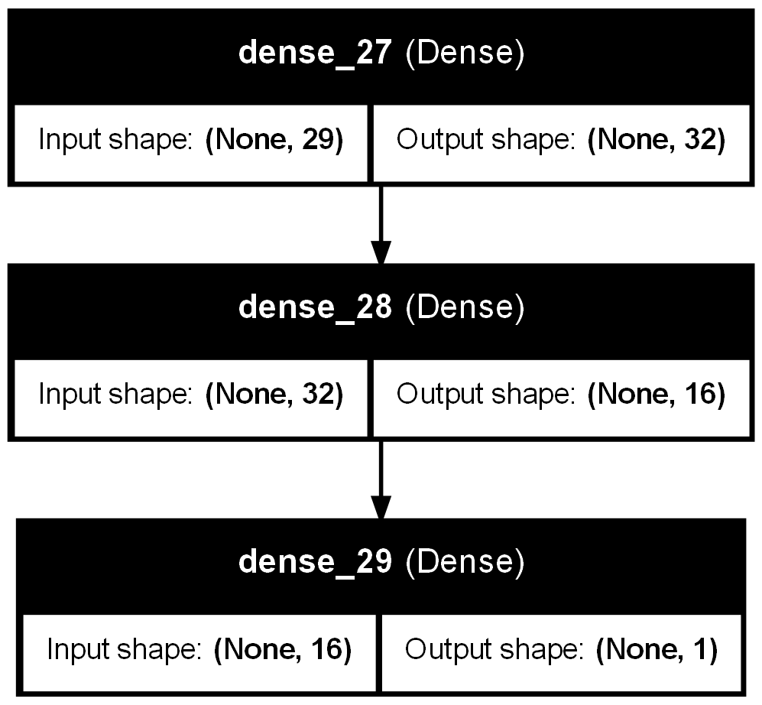
Compilation: The model is compiled with the following configurations:
Loss Function: Binary cross-entropy, appropriate for binary classification problems.
Optimizer: Adam optimizer, known for its efficiency in handling sparse gradients and adaptive learning rate capabilities.
Metrics: Accuracy, to evaluate the model’s performance during training and validation

Slide 9
Cross-Validation Technique
Training: The training process incorporates K-fold cross-validation with 5 splits, enhancing the model’s robustness and generalizability:
Early Stopping: A callback that stops training when the validation loss does not decrease for 10 consecutive epochs, preventing overfitting and ensuring generalization.
Epochs: Up to 100 training epochs, though early stopping may halt training sooner.
Validation: Each training epoch is validated on a respective validation fold to monitor performance on unseen data.
Verbosity: Set to 0 to suppress output during thetraining process.
Evaluation:
After training on each fold, the model is evaluated on the corresponding validation set:
Accuracy for each fold: Displays how well the model performed on each validation fold.
Average Accuracy: Calculated from the accuracies of all folds, providing an overall metric of model performance across the cross-validation process.

Slide 10
4. Dataset Features
Dataset Features Description
Age: The patient’s age. (Continuous)
Sex: The patient’s gender (0 for female, 1 for male) (Categorical)
Chest Pain Type (cp): (Categorical)
Value 0: Typical Angina
Value 1: Atypical Angina
Value 2: Non-Anginal Pain
Value 3: Asymptomatic
Resting Blood Pressure (trtbps): (Continuous)
Serum Cholesterol Levels (chol): (Continuous)
Fasting Blood Sugar (fbs): (Categorical)
Value 0: ≤ 120 mg/dL
Value 1: > 120 mg/dL
Resting ECG Results (restecg): (Categorical)
Value 0: Normal
Value 1: ST-T Wave Abnormality
Value 2: Probable or Definite Left Ventricular Hypertrophy

Slide 11
4. DATASET FEATURES
Maximum Heart Rate During Exercise (thalachh): (Continuous)
Exercise-Induced Angina (exng): (Categorical)
Value 0: No
Value 1: Yes
ST-Segment Depression (oldpeak): (Continuous)
Slope of ST Segment (slp): (Categorical)
Value 0: Downsloping
Value 1: Flat
Value 2: Upsloping diagnosis
Number of Major Vessels Colored by Fluoroscopy (caa): (Categorical)
Thalassemia Type (thall): (Categorical)
Value 0: None (Normal)
Value 1: Fixed Defect
Value 2: Reversible Defect
Value 3: Thalassemia
Risk of Heart Attack (output): (Categorical)
Value 0: No
Value 1: Yes

Slide 12
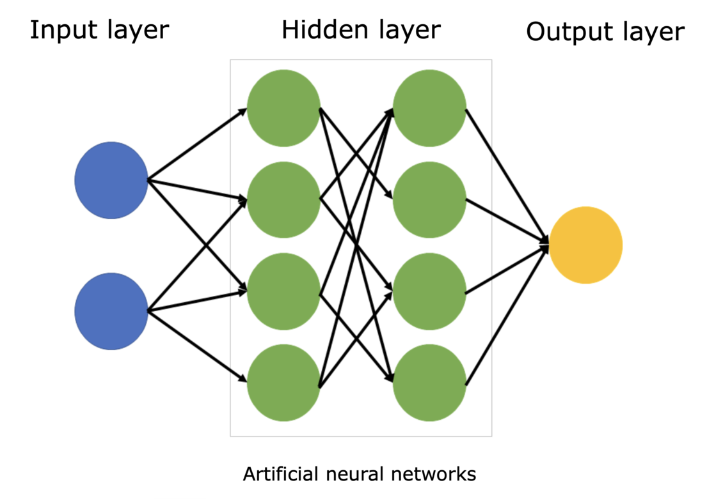
5. Model Development
Architecture Overview:
The neural network architecture comprises an input layer, hidden layers, and an output layer. Each layer contains neurons responsible for processing data. The input layer receives features, hidden layers perform computations through weighted sums and activation functions, and the output layer provides predictions. The number of neurons and layers, as well as activation functions, are determined during model development.
Training Process:
The training process involves several steps:
1.Data Preprocessing: Scaling, encoding, and sampling techniques are applied to prepare the data for training.
2.Model Building and Training: Using TensorFlow's Keras API, the model architecture is defined, and the learning process is configured with cross-validation. The model is trained iteratively to optimize performance.
3.Evaluation: Model performance is assessed using metrics such as accuracy, F1-score, and ROC curves to ensure robustness and generalization capability.
Cross-validation is employed to validate the model's performance across multiple subsets of the data, enhancing reliability and reducing overfitting.By meticulously tuning parameters and evaluating the model's performance, this approach ensures the development of a reliable and accurate predictive model for heart attack occurrences.

Slide 13
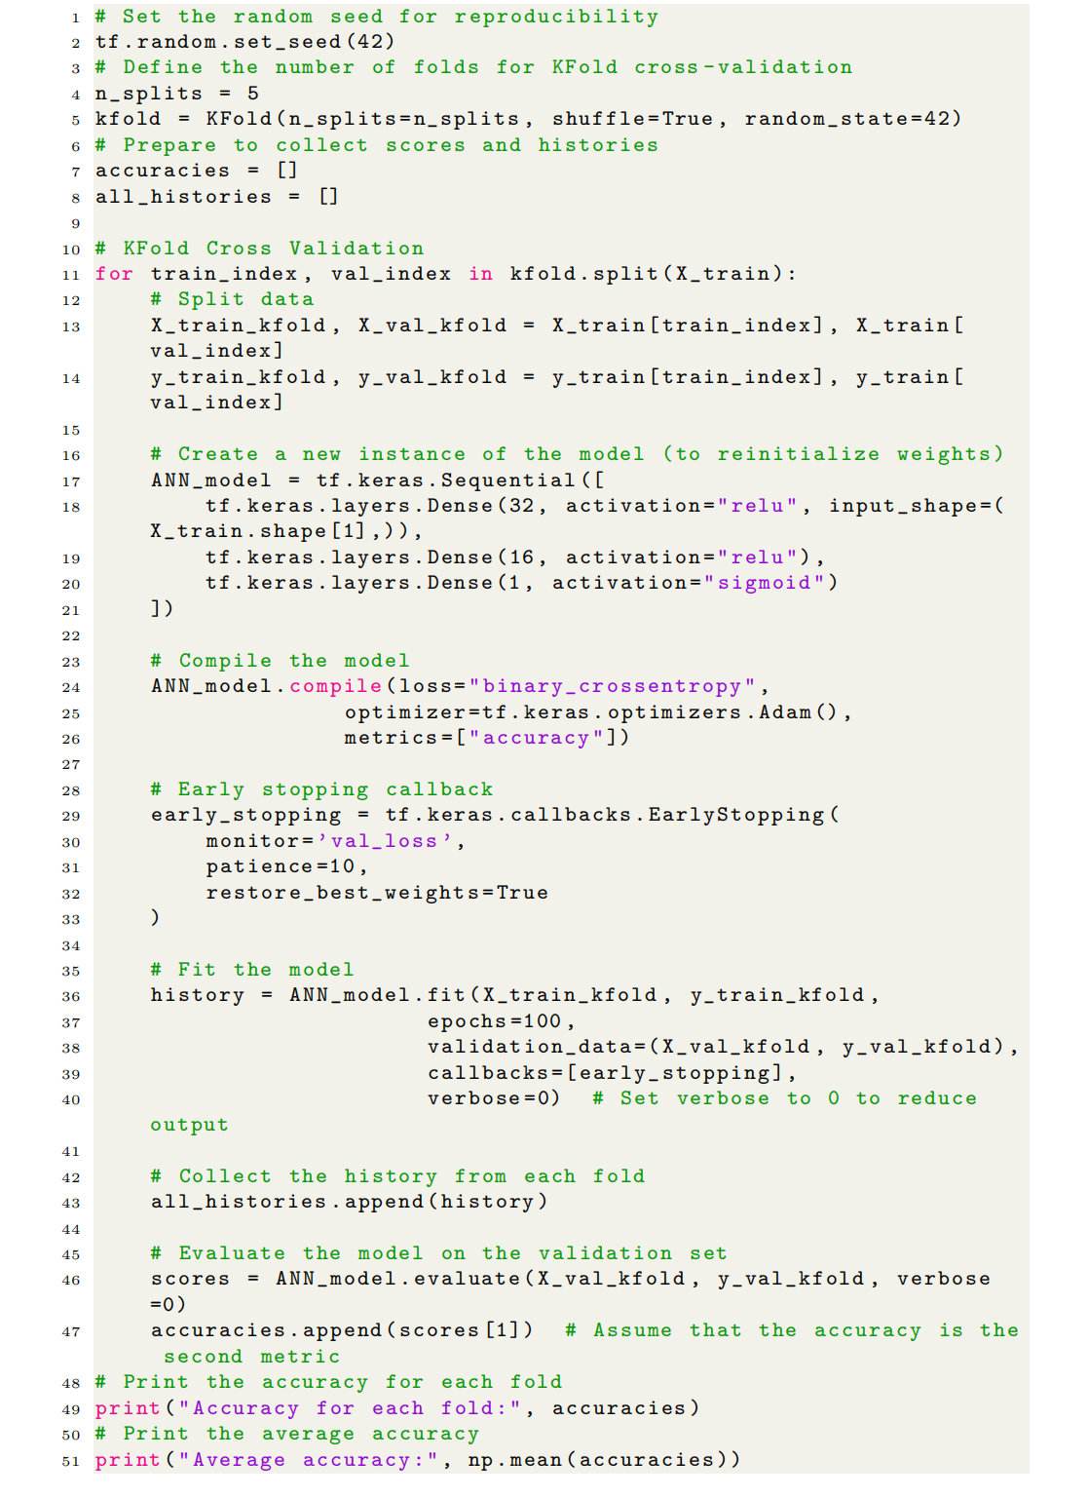
5. MODEL DEVELOPMENT
Source Code Snippet:
This setup ensures robust analysis and prediction on unseen data, optimizing the training process with mech anisms such as early stopping, making the model both
efficient and effective.

Slide 14
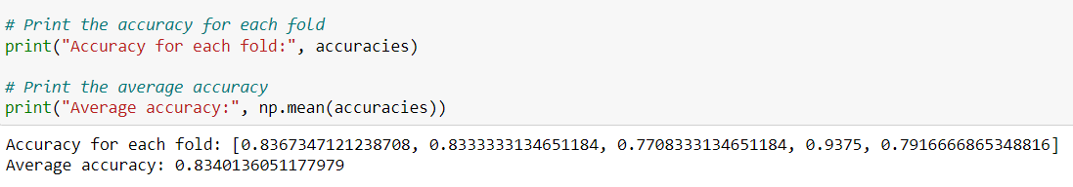
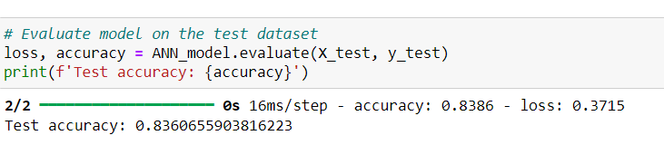
6. rESULTS
Performance Metrics: When using the model with the Artificial Neural Networkalgorithm, the following results were produced:
The best accuracy rate: 88.5%
Run the ANN model:
The model was run more than once and we obtained the following results:
Figure 6.1: Results of training the model for the 1st time
Figure 6.2: Test accuracy for 1st time

Slide 15
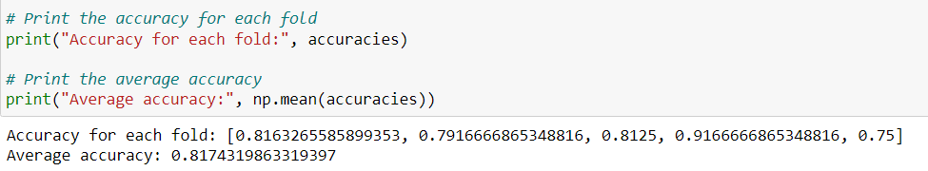
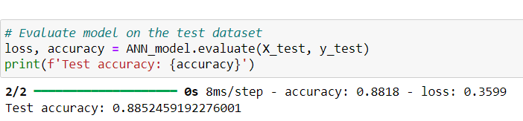
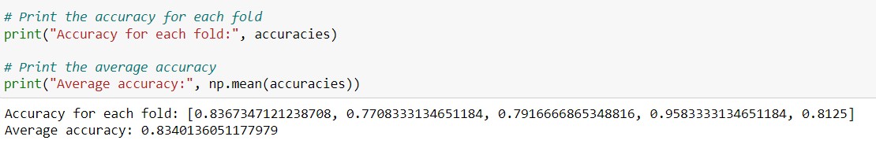
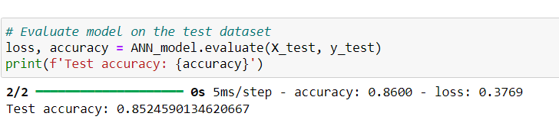
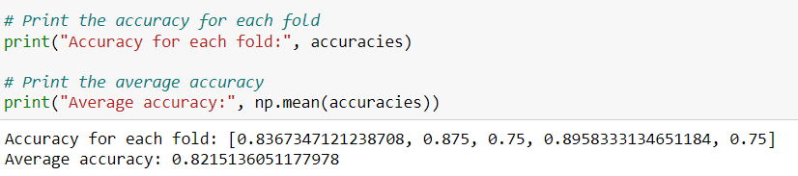
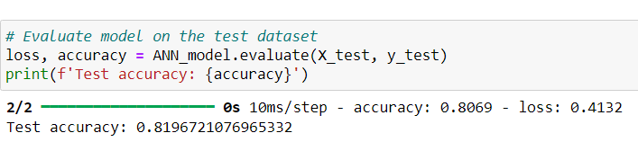
6. rESULTS
Figure 6.3: Results of training the model for the 2nd time
Figure 6.4: Test accuracy for 2nd time
Figure 6.5: Results of training the model for the 3rd time
Figure 6.6: Test accuracy for the 3rd time
Figure 6.7: Results of training the model for the 4th time
Figure 6.8: Test accuracy for the 4th time

Slide 16
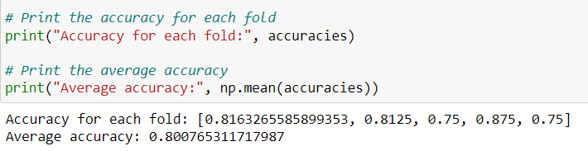
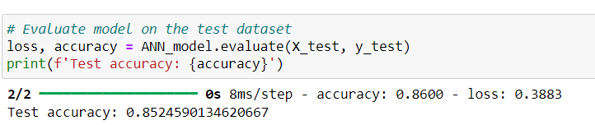
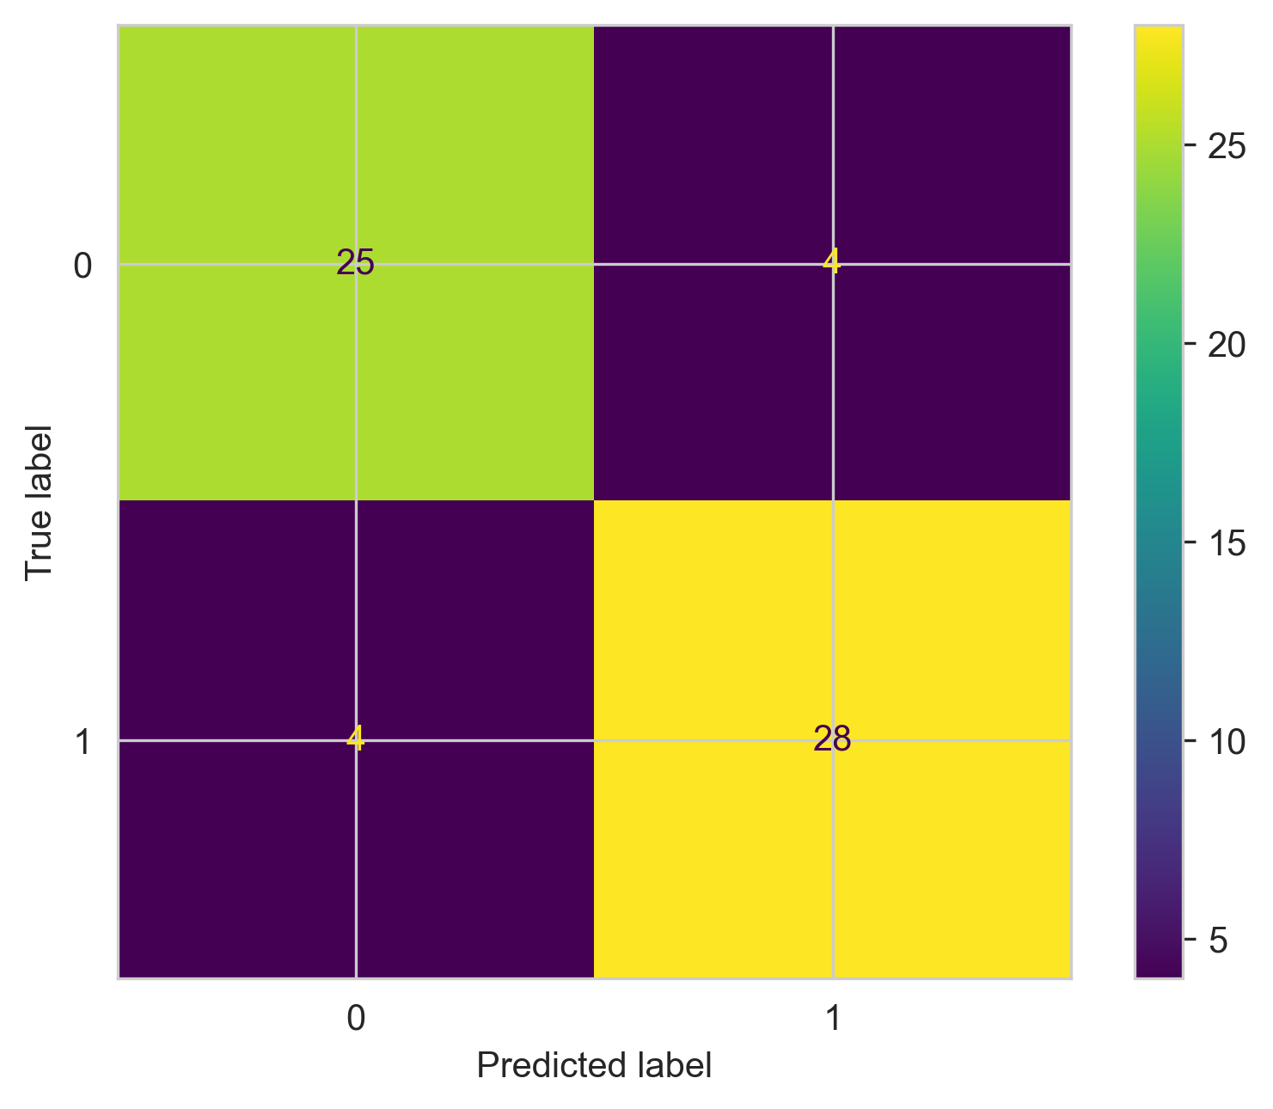
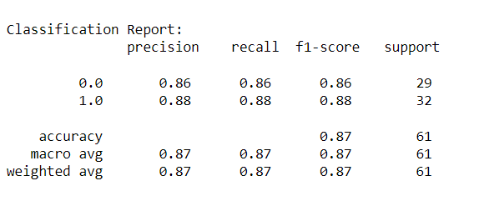
6. rESULTS
Figure 6.9: Results of training the model for the 5th time
Figure 6.10: Test accuracy for the 5th time
Plot confusion matrix:
Classification report:

Slide 17
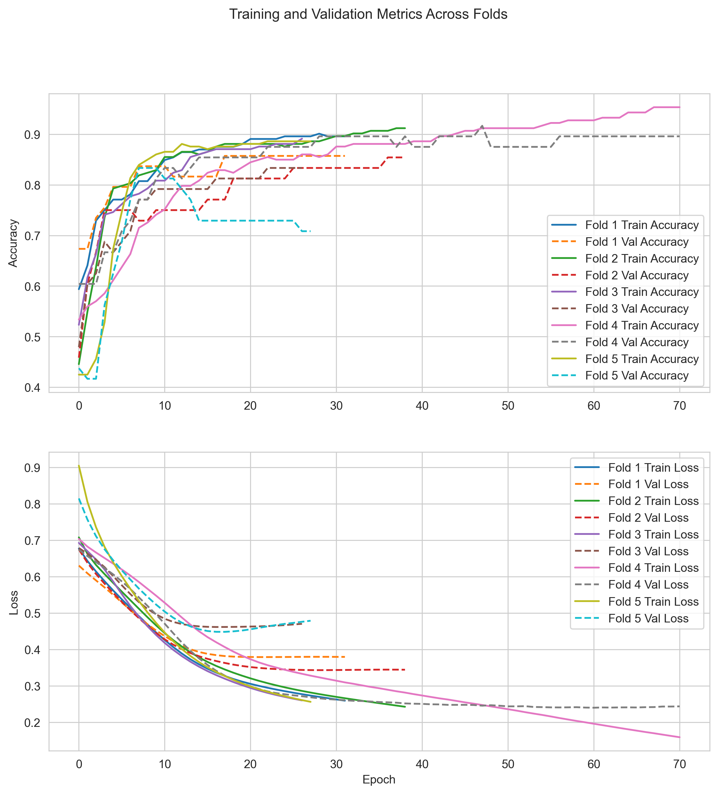
6. rESULTS
Visuals of Results
We conducted a test of the model and obtained the following results:
Plots training and validation accuracy and loss for each fold on shared plots

Slide 18
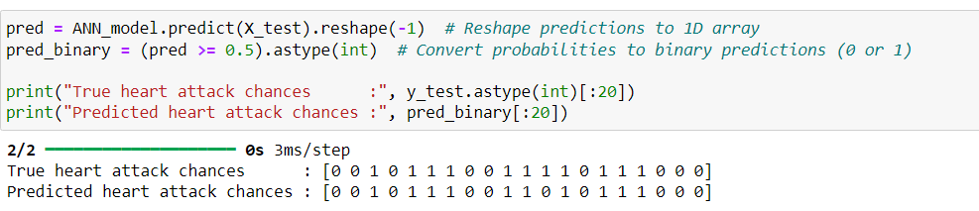
7. Discussion
Analysis of Results :
Discussion of Previous Results:
Variability and Average Performance: Accuracy ranges from 81.9% to 88.5%, with an average around 85%. Indicates dependence on training data,typical in real-world scenarios.
Highest Achieved Accuracy: The high of 88.5% under favorable conditions suggests good model performance potential.
Quality of the Results:
Consistency: Model shows reasonable consistency with minor deviations in fold performances, suggesting appropriate architecture and training.
Figure 7.1: Showing the first 20 items of model prediction results

Slide 19
7. Discussion
Challenges & Learnings :
During the development of our heart attack prediction model using Artificial Neural Networks (ANN), we faced several obstacles that provided valuable learning opportunities:
Data Quality and Preprocessing:
Challenge: The initial dataset contained missing values, inconsistencies,and imbalanced classes, which could adversely affect model training.
Learning: We learned the importance of thorough data cleaning and preprocessing. Implementing techniques like imputation for missing values, normalization of continuous features, and oversampling for the minority class helped improve the dataset quality and model performance.
Model Selection and Tuning:
Challenge: Choosing the optimal architecture and hyperparameters for the ANN was difficult due to the numerous possible configurations.
Learning: We discovered the value of systematic experimentation. Using techniques like K-fold cross-validation, grid search for hyperparameter tuning, and early stopping for preventing overfitting helped us identify the best-performing model configurations.

Slide 20
7. Discussion
Computational Resources:
Challenge: Training the ANN on a large dataset with multiple configurations was computationally intensive and time-consuming.
Learning: We learned to optimize our computational resources effectively.Utilizing cloud-based platforms with GPU support, setting realistic training parameters, and parallelizing processes where possible greatly enhanced our efficiency.
Model Evaluation:
Challenge: Evaluating the model’s performance across different folds and ensuring its generalizability to unseen data was complex.
Learning: The importance of comprehensive evaluation became evident.By consistently monitoring metrics such as accuracy, precision, recall, and the confusion matrix across all validation folds, we ensured a robust assessment of the model’s performance.
Interpreting Results:
Challenge: Understanding and interpreting the model’s outputs, especially in terms of clinical relevance, required careful consideration.
Learning: We realized the necessity of domain knowledge in interpreting results. Consulting with healthcare professionals and using domain specific metrics to evaluate model predictions helped in making the results more meaningful and applicable.
Overall, these challenges reinforced the significance of a meticulous and iterative approach to machine learning projects, underscoring the importance of data quality, model validation, and interdisciplinary collaboration.

Slide 21
8. Conclusions and Future Work
Conclusions:
The machine learning project aimed at predicting heart attack occurrences using Artificial Neural Networks (ANN) demonstrated promising outcomes. Key conclusions from the project include:
1. Model Effectiveness: The ANN model achieved abest accuracy rate of 88.5%, with performance variability across different folds indicating typical realworld scenario challenges.
2. Robustness and Generalization: The use of K-fold cross-validation ensured the model’s robustness
and ability to generalize well over unseen data, supported by the systematic approach to training and evaluation.
3. Efficiency: Early stopping during training prevented overfitting and enhanced computational efficiency,showcasing the model’s capability to perform under optimal and limited resource scenarios.

Slide 22
8. Conclusions and Future Work
Recommendations for Future Work:
Based on the project’s outcomes, the following recommendations are proposed to enhance future work:
1. Hyperparameter Tuning: Further exploration of hyperparameters such as the number of layers, neurons, and learning rates could potentially improve the model’s accuracy and efficiency.
2. Advanced Architectures: Investigating more complex network architectures like Convolutional Neural Networks (CNNs) or Recurrent Neural Networks(RNNs) may provide better insights and predictionsdue to their advanced pattern recognition capabilities.
3. Data Augmentation: Increasing the dataset size or implementing data augmentation strategies could help the model learn more comprehensive patterns,improving both accuracy and generalization.
.4Feature Engineering: Additional feature engineering might uncover more subtle patterns in the data that could significantly impact model performance.
5. Regularization Techniques: Integrating advanced regularization techniques like dropout could reduce overfitting further and enhance the model’s prediction on new, unseen data.
6. Cross-disciplinary Approaches: Combining insights from fields such as epidemiology with machine learning could refine predictions and lead to more personalized healthcare interventions.
These enhancements could drive forward the development of more sophisticated models, ultimately contributing to the early detection and prevention of heart attacks.

Slide 23
9.REFERENCES
[1] A. G´eron, ”Hands-On Machine Learning with ScikitLearn, Keras, and TensorFlow: Concepts, Tools,
and Techniques to Build Intelligent Systems,” 3rd ed., O’Reilly Media, Inc., 2021, ch. 10, ”Introduction to Artificial Neural Networks with Keras.”
[2] A. Zhang, Z. C. Lipton, M. Li, and A. J. Smola,”Dive into Deep Learning,” available online: Dive into Deep Learning
[3] ”Flowchart for Artificial Neural Network (ANN),” ResearchGate, 2020, [Online]. Available: Flowchart for ANN.
[4] ”Mathematics of artificial neural networks,” Wikipedia, [Online]. Available: Mathematics of ANNs.
[5] XenonStack, ”Artificial Neural Network Applications,” 2023, available online: ANN Applications.
[6] P. Singh, ”First Neural Network for Beginners Explained with Code,” Towards Data Science, July 15,2020, [Online]. Available: First Neural Network.
[7] MLTut, ”Implementation of Artificial Neural Network in Python,” available online: Implementation of ANN in Python.
[8] D. F. Campos, ”Neural Network Cross Validation and Visualization,” Kaggle, 2023, available online: Neural Network Cross Validation.
[9] neoglez, ”K-Fold and ANN,” GitHub, 2022, [Online]. Available: K-Fold and ANN on GitHub.
[10] S. Gunjal, ”Tutorial: K-Fold Cross-Validation,”Kaggle, 2023, [Online]. Available: K-Fold Cross-Validation.
[11] S. MechLearn, ”Deep Tutorial 1: ANN and Classification,” Kaggle, 2023, [Online]. Available: Deep Tutorial 1.
[12] Stack Exchange, ”K-Fold Cross-Validation,” Baeldung on CS, 2023, [Online]. Available: K-Fold Cross-Validation Article.
[13] ”Pseudo-code of the back-propagation algorithm in training ANN,” ResearchGate, 2018, [Online]. Available: Pseudo-code of back-propagation.
[14] ”Optimization Methods for Large-Scale Machine Learning,” Semantic Scholar, 2017, [Online]. Available: Optimization Methods.
[15] ”What is the time complexity for training a neural network using back-propagation?,” Artificial Intelligence Stack Exchange, 2019, [Online]. Available: Time Complexity for Training ANN.

Slide 24
10.APPENDIX
Project Source Codes:
To facilitate further learning and replication of our project’s results, we have made the codebase available online. This allows educators, students, and other researchers to view,download, and modify the source code according to their needs.
Overview of the Code Repository:
The code for this project is hosted on GitHub, a popular platform for version control and collaboration. It includes detailed documentation on how to set up the environment, run the models, and interpret the results.
How to Access the Code
The project code can be accessed through the following link:
Project Source Codes Link on GitHub
Please ensure you have Git installed on your system to clone the repository. You can clone the project using the following command in your terminal:
#!/bin/bash
# Script to clone the project repository
git clone https://github.com/Islam-hady9/Heart-Attack-Analysis-Prediction-using-ANN.git

Slide 25
10.APPENDIX
Navigating the Repository:
The repository is structured as follows:
/docs: Documentation files and additional resources
/src: Complete source code for this project
/data: Dataset used in this project
/results: Output results and graphs for reference
/presentations: Presentation for this project
11.CONTACT INFORMATION:
Support and Contact
Should you encounter any issues or have questions regarding the project code, please open an issue on the GitHub repository, or contact us directly at eslamabdo71239@gmail.com.

Slide 26
Thanks 🥰

